Slide 1
High Performance Computing - Cache
Nguyen The Duy Khanh - 005019181

Slide 2
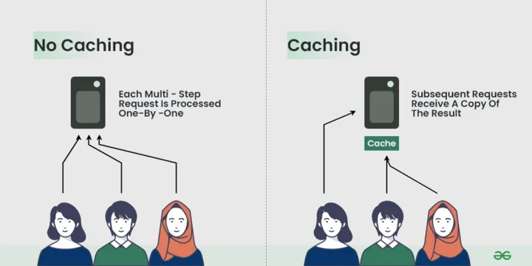
Overview
Caching is an optimization technique that we can use in our applications to keep recent or often-used data in memory locations that are faster or computationally cheaper to access than their source.
The three primary types of caching are:
  Key-value caching
  Object caching
  Distributed caching

Slide 3
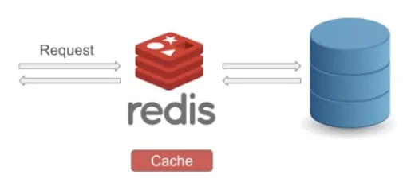
Cache benefits
Decreased network costs
Improved responsiveness
Increased performance on the same hardware
Availability of content during network interruptions

Slide 4
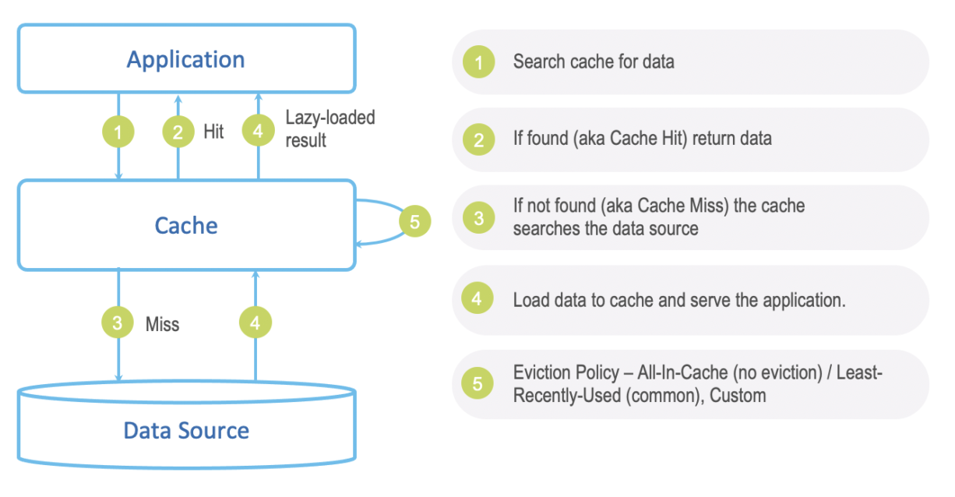
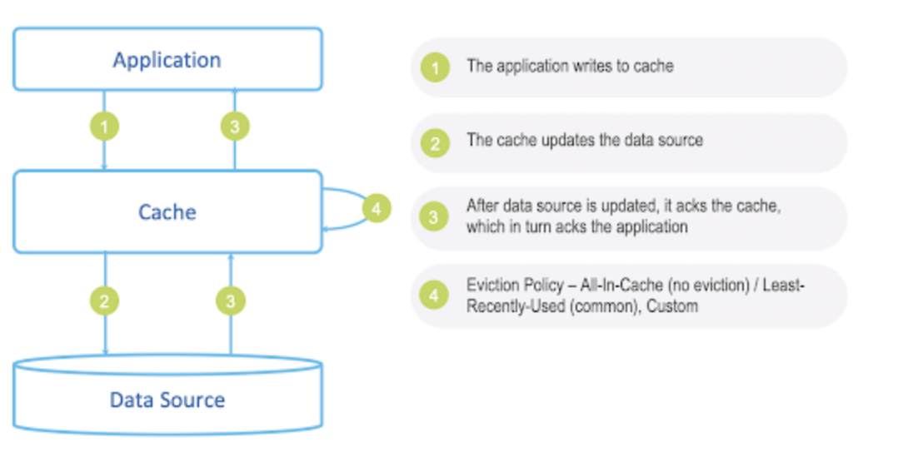
Cache Strategies
Write through
Instead of writing directly to the main database, the application writes to the cache as if it were the main database.
Read through
When looking for a specific ID, the application will hit the cache first; if the data is missing, then the cache will be responsible for pulling the data from the main database and updating it.
Write Behind
Similar to write through, except writing to the main database is done asynchronously

Slide 5
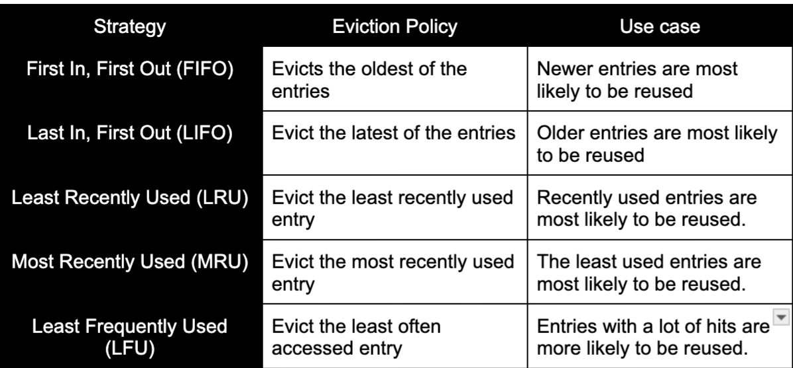
Cache eviction policy
The cache will grow indefinitely, and it can lead to out-of-memory (OOM) if we keep add the key and corresponding value to the cache
To avoid that, a cache eviction policy is needed to manage the cached information and choose which items to discard to make room for new ones

Slide 6
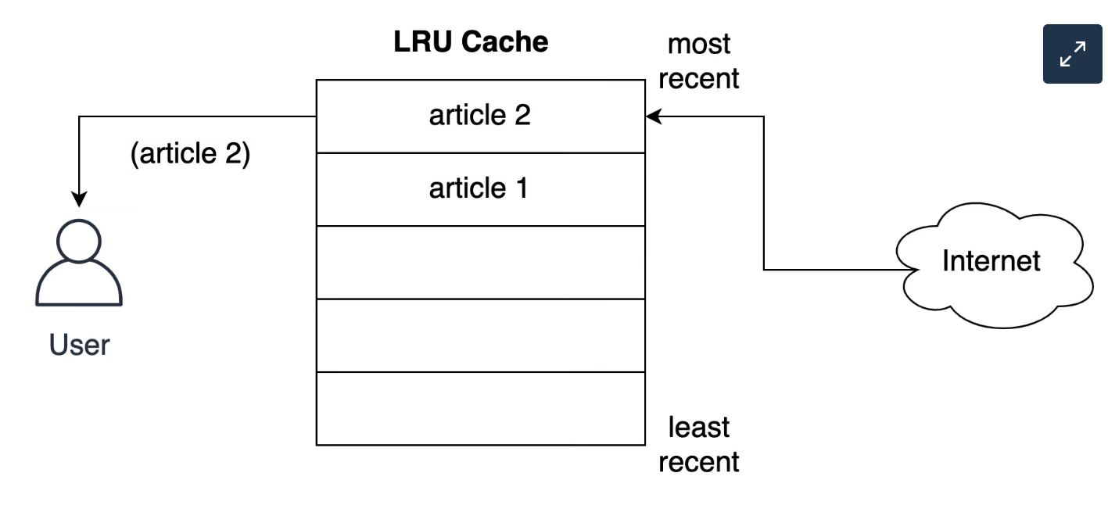
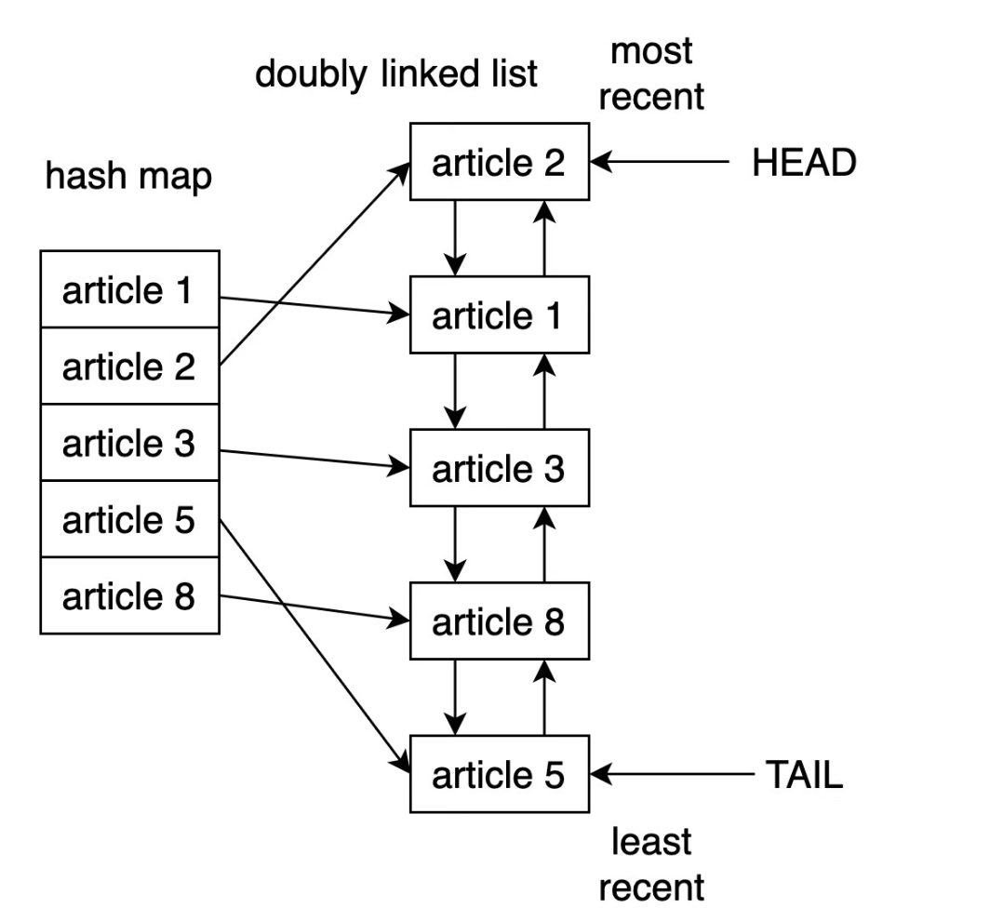
Least Recently Used (LRU)
A cache implemented using the LRU strategy organizes its items in order of use. Every time the application access an entry, the LRU algorithm will move it to the top of the cache. This way, the algorithm can quickly identify the entry that’s gone unused the longest by looking at the bottom of the list.
One way to implement an LRU cache is to use a combination of a doubly linked list and a hash map.

Slide 7
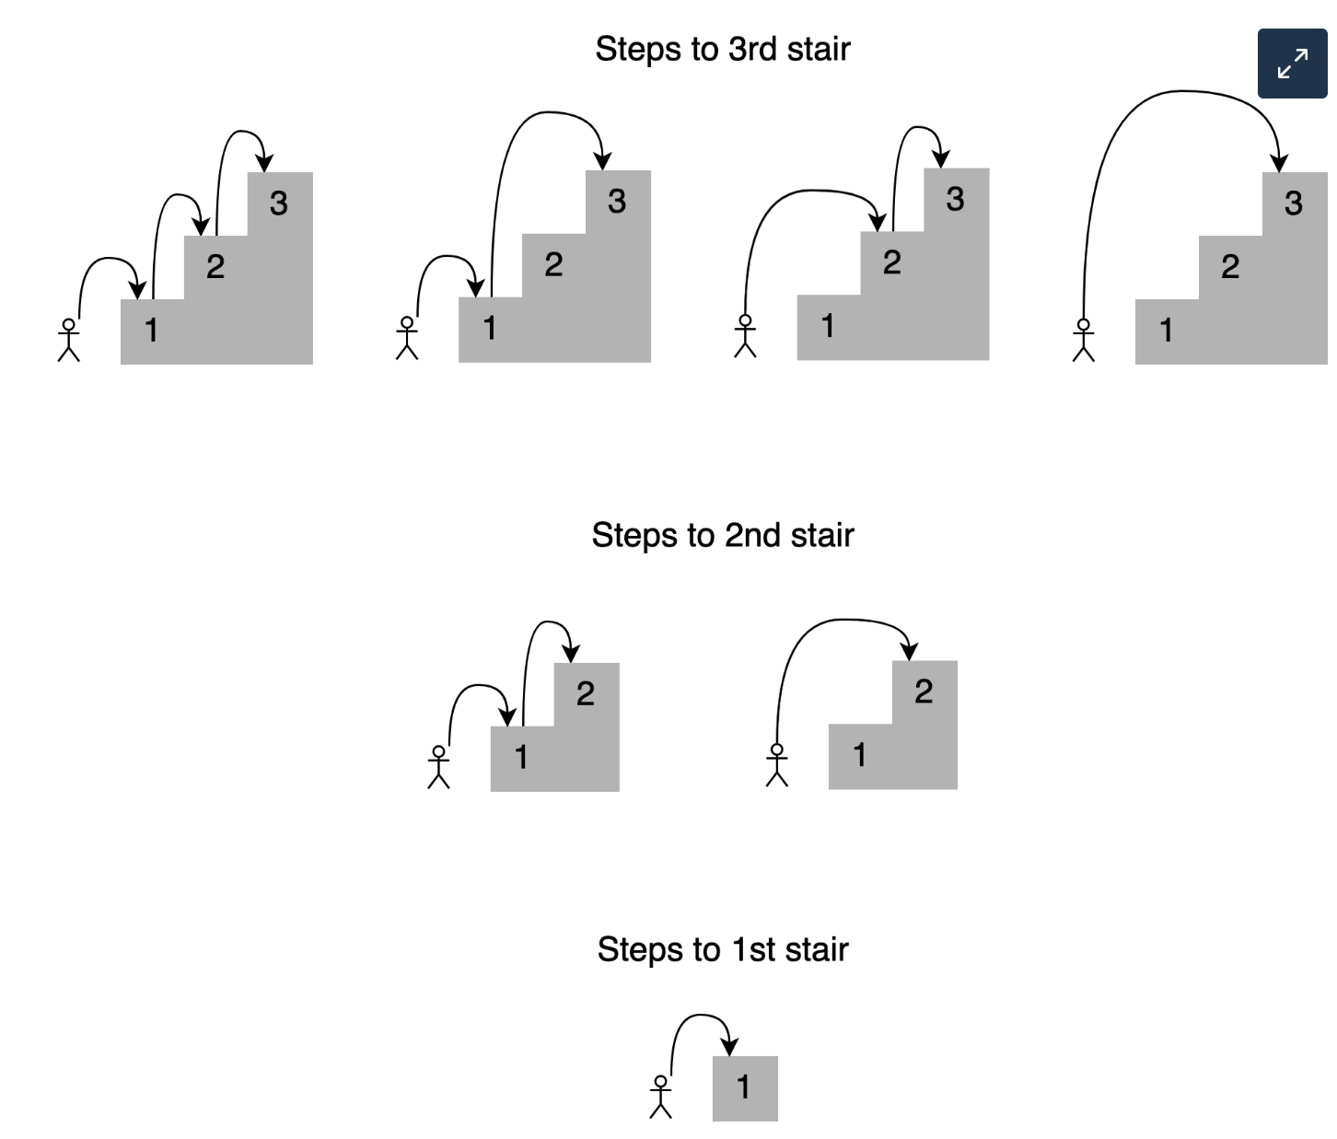
Practical Problem
A person is standing at the bottom of a staircase with n steps. The person can climb either 1 step, 2 steps, or in some variations, even 3 steps at a time. The problem is to count the number of distinct ways to reach the top of the staircase.
Example: 4 ways to reach out to steps 3

Slide 8
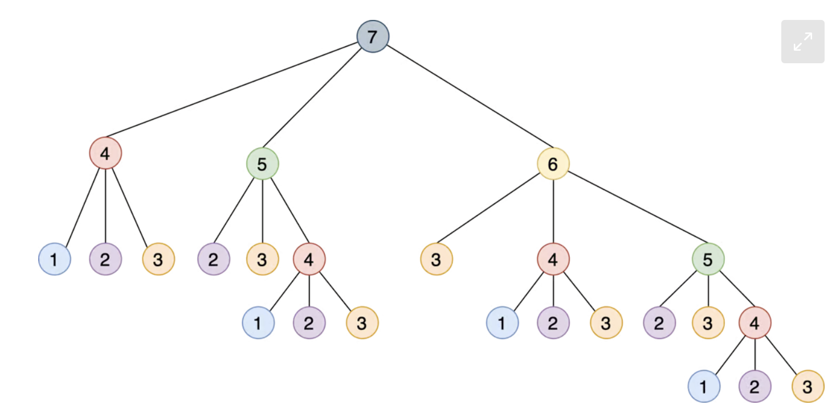
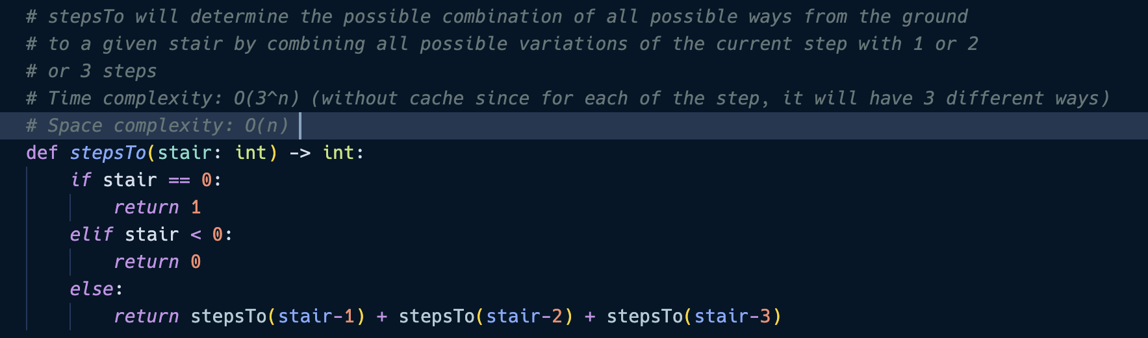
Practical Implementation
Overlapping sub-problems when calculating the combination (e.g stepsTo(4)).
As the stair grows, the number of repeated calculations increases exponentially, making the function inefficient. Therefore, memorization with cache

Slide 9
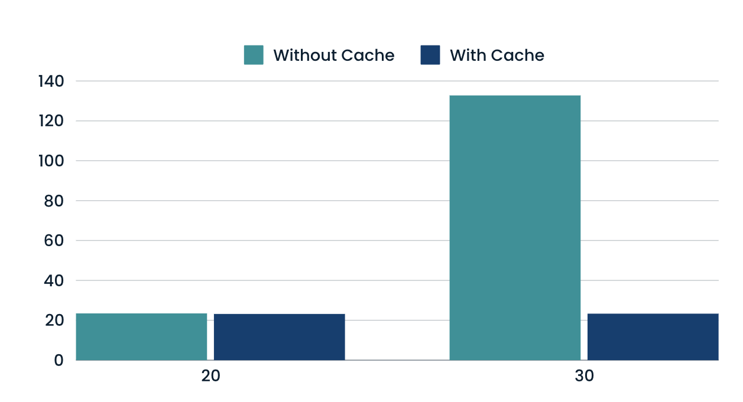
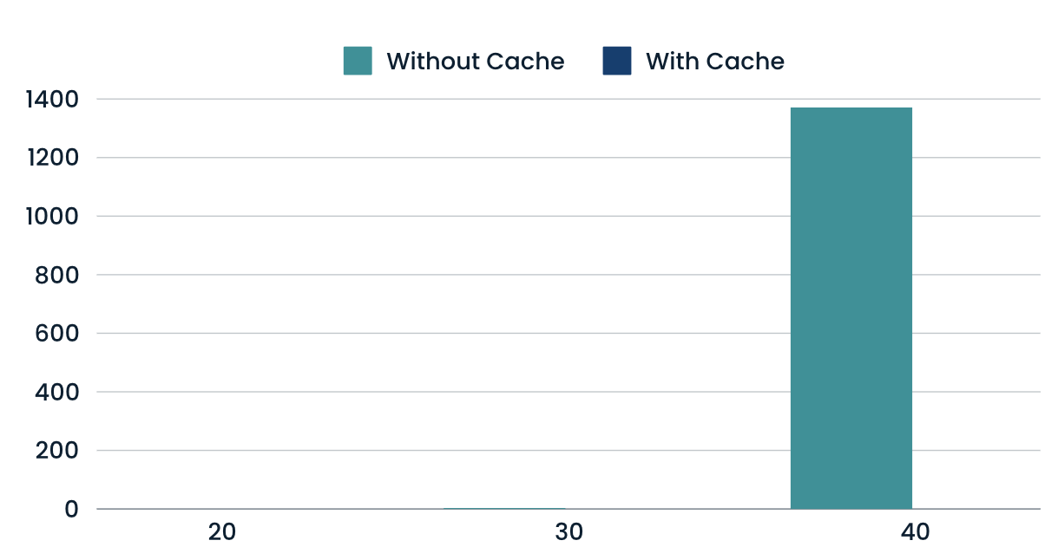
Comparison
There has been an improvement from 1371 seconds to 0 seconds with Cache for the staircase problem at 40. As for space complexity, there has been an improvement from 132.76 MiB to 23.312 MiB.
Time complexity without Cache: O(3 ^ n)
Time complexity with Cache: O(n) (each stair is calculated exactly once)

Slide 10
Questions?

